Slide 1

INSTRUCTION TUNING FOR CODE LLMS: A SELF-ALIGNMENT PIPELINE WITH STARCODER2 AND THE STACK V2
Course: Deep Learning (DS677004)
Jedidiah Mathangi (jm2526)
Banu Werma Khallepalli (bk396)
Jnana Harshavardhan Pechetti (jp2334)

Slide 2
INTRODUCTION
The main objective of our project was to build high-quality instruction-response datasets for code-based large language models, especially focusing on Java — a widely used but underrepresented language in instruction-tuned datasets.
We used StarCoder2-15B as the model and leveraged a novel self-alignment pipeline called SelfCodeAlign. Our goal was to automate the generation, instruction, and validation of Java functions in a structured and scalable way.
This project matters because instruction tuning helps code LLMs generalize better and become more usable for real-world programming tasks — and our pipeline shows how this can be done automatically with high precision

Slide 3
PIPELINE OVERVIEW
The pipeline has 3 major stages:
Seed Gathering: Extract function-level units from raw Java code.
Self-OSS-Instruct: Generate comments and instructions.
Self-Validation: Generate model responses and validate output.

Slide 4
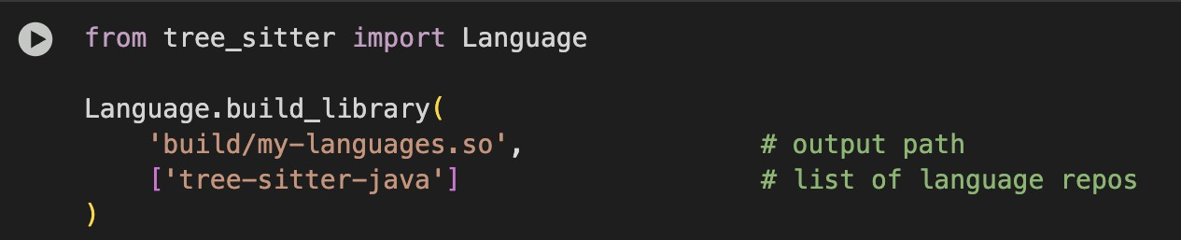
STEP 1: SEED GATHERING
In step-1(filtering) we took a dataset from a hugging face. We took data from java, and we filtered the return statement functions with some conditions.
We cloned the selfcode git repository. We started Seed gathering.
We used a tree-sitter module for parsing.
Filtering Java Functions:
We focused on extracting functions with return statements.
Used Tree-sitter, a parser generator tool, to analyze the code structure and identify function-level units.
Filtered out functions with compilation errors, incomplete logic, or invalid syntax.

Slide 5
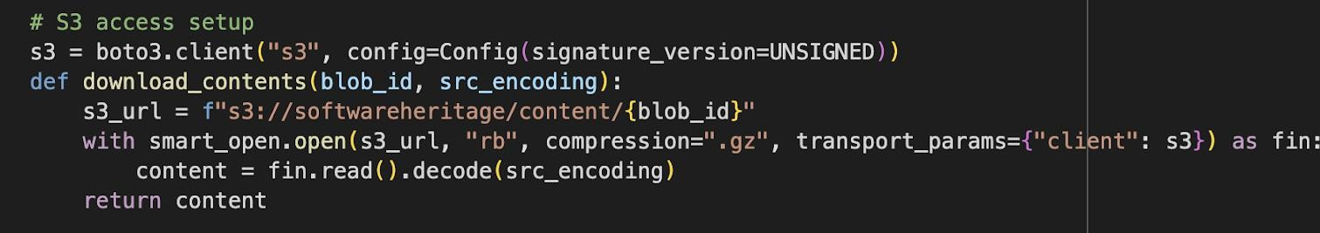
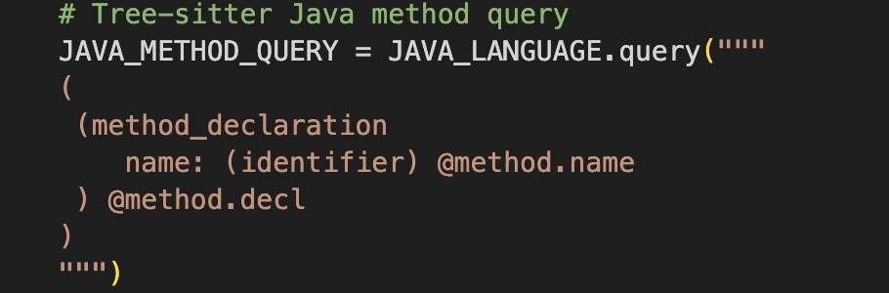
From boto3 we took dataset contents
The JAVA_LANGUAGE object loads Java grammar from a compiled shared library (my - languages.so).
smart_open streams the gzipped source code directly from S3 and decompresses it.
Dataset loads the "bigcode/the-stack-v2-dedup" dataset with Java language split.
showing flow from S3 -> Download source -> Parse with Tree-sitter -> Extract methods -> Store results

Slide 6
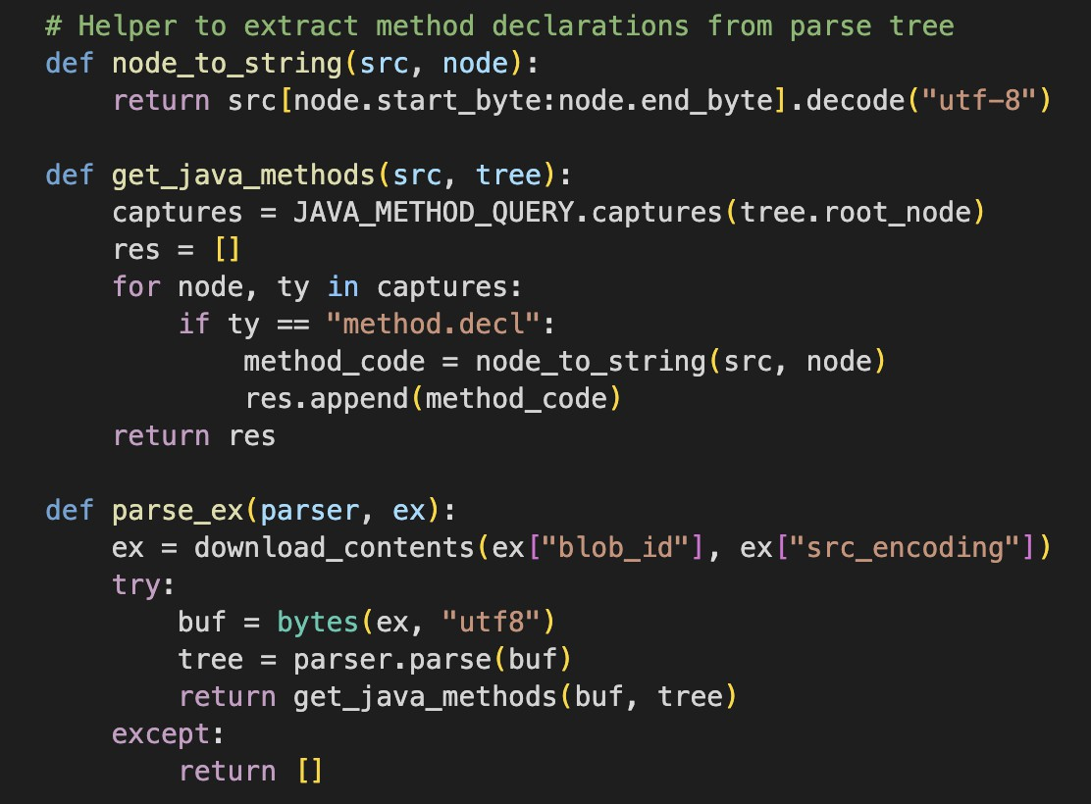
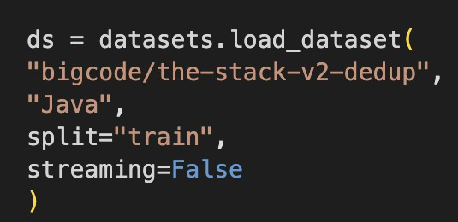
node_to_string(src, node) extracts the source substring for a given Tree-sitter node.
Used to convert the method node back into a Java method code string.
get_java_methods(src, tree) uses the pre-defined Tree-sitter query to find all method declarations in the parse tree.
parse_ex(parser, ex) downloads source code from S3, parses it using Tree-sitter, and extracts methods.
process_chunk(idx_and_chunk) processes a batch (chunk) of examples in parallel, using multiple parser instances (one per process).
As dataset is massive, we created them into subsets and processing them
ds = datasets.load_dataset("bigcode/the-stack-v2-dedup", "Java",split="train",streaming=False)

Slide 7
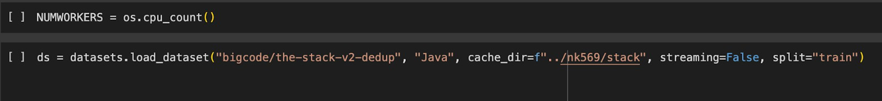
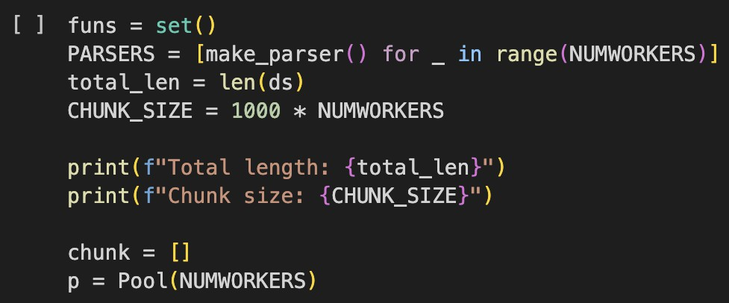
We didn’t call main function directly we ran them line by line
This code initializes the number of available CPU cores and loads the Java training dataset from The Stack v2, storing it locally for efficient access.
It's a core part of Step 1(Seed Gathering), used before parsing and filtering Java functions.
Then we created functions into a set to remove repeated functions
Total length: 124255350
Chunk size: 16000

Slide 8
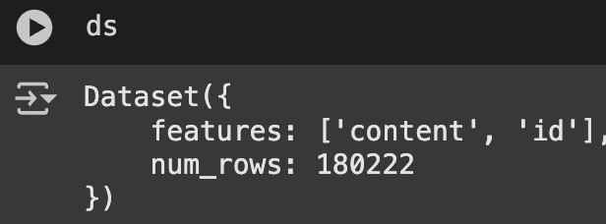
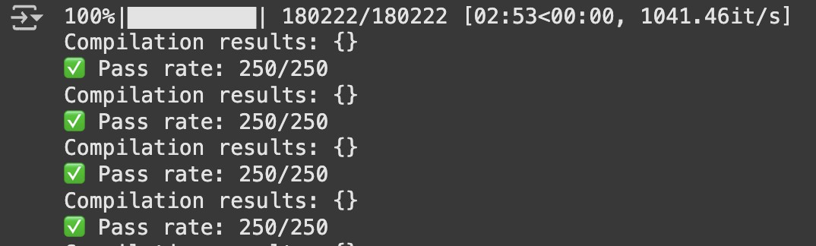
When we got the required functions, we terminated the process using (Keyboard Interrupt) After converting from dictionary to hugging face format then we get
So, after that we filtered only return statements

Slide 9
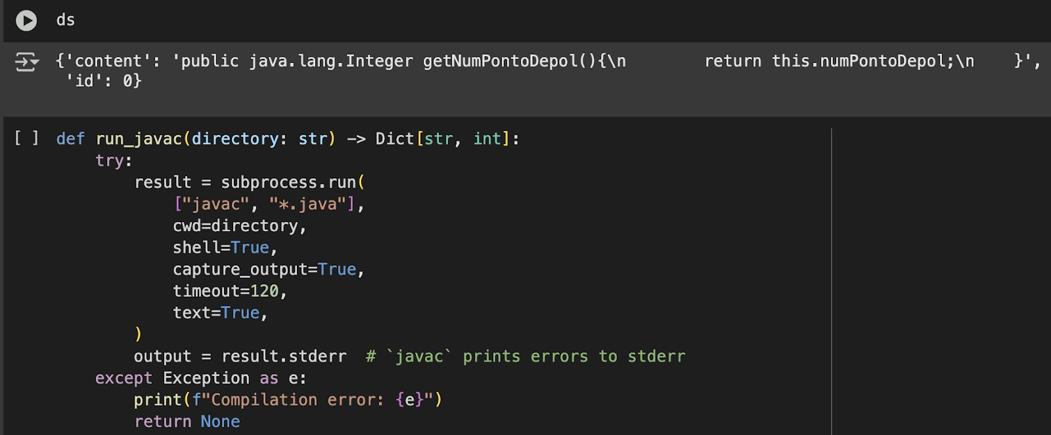
We also filtered proper java functions. We do not consider any functions which have compilation errors.
All 180222 passed the test. filtering is completed. We saved it into seed2 file

Slide 10
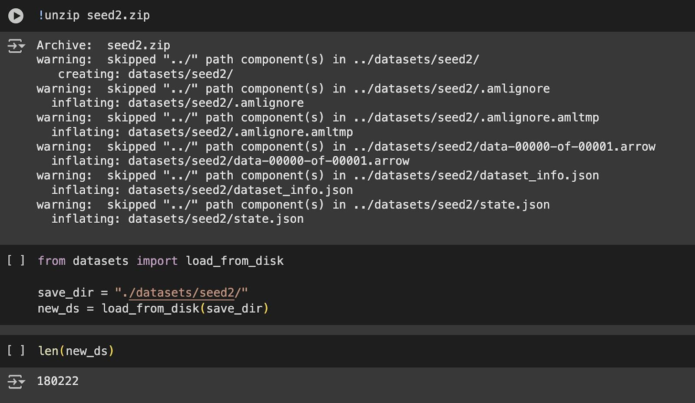
As we needed a proper GPU. We used Google Colab for this step.
We installed the necessary requirements needed for step-2. We have cpu_count(12)

Slide 11
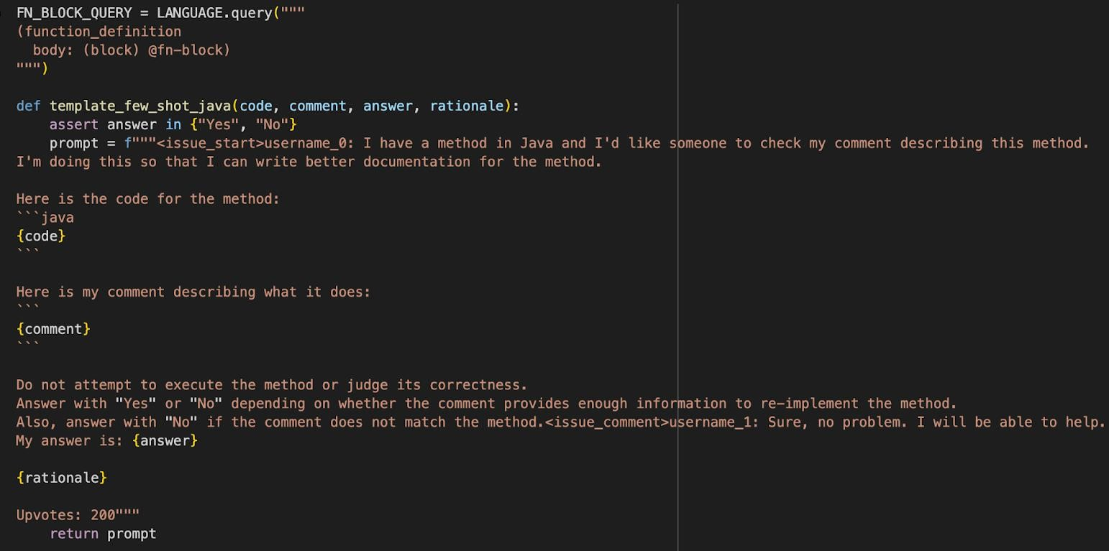
We tried using vLLM, but we got torch issues. So, we used OpenLLM.
We created a language query by using template prompt, then we created instructions for LLM.
This function creates a few-shot prompt for evaluating whether a natural language comment accurately describes a given Java method

Slide 12
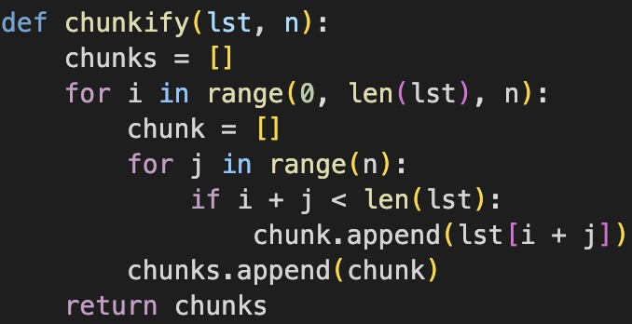
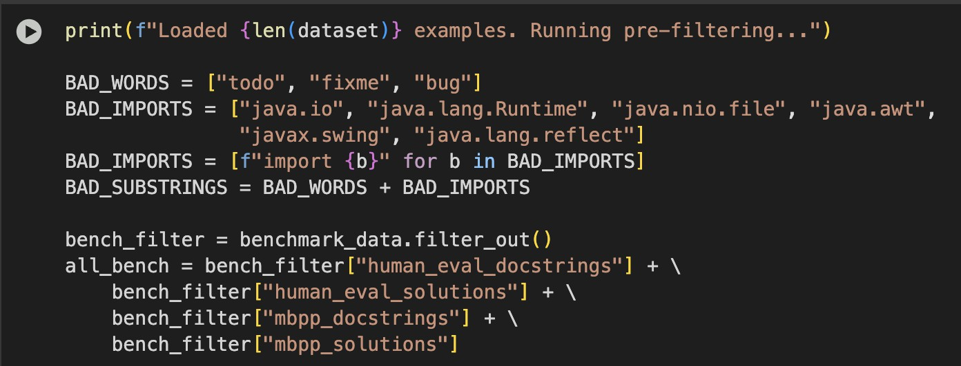
Then we defined this function for creating chunks.
Useful for batch processing, parallel computing, or rate-limited API calls.
Then we used bad words like ‘todo’, ‘fixme’, ‘bug’ to filter the java code and to not consider these lists.
benchmark_data.filter_out(). Removes benchmark examples that may overlap with training data to prevent data leakage.

Slide 13
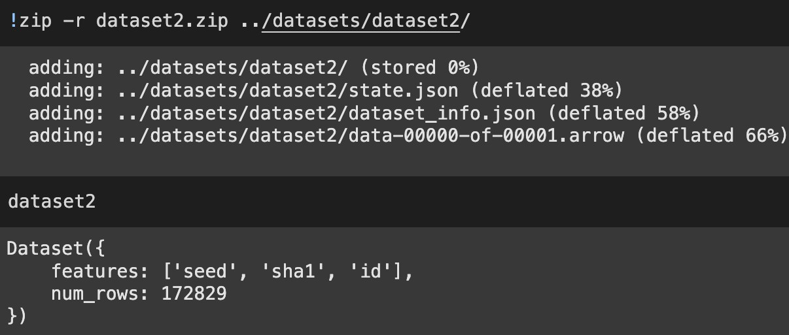
After filtering we got 17289 and we renamed it as seed and saved this into dataset2.
After this, we connected OpenAI API and then gave the prompts we used to check the accuracy of the code

Slide 14
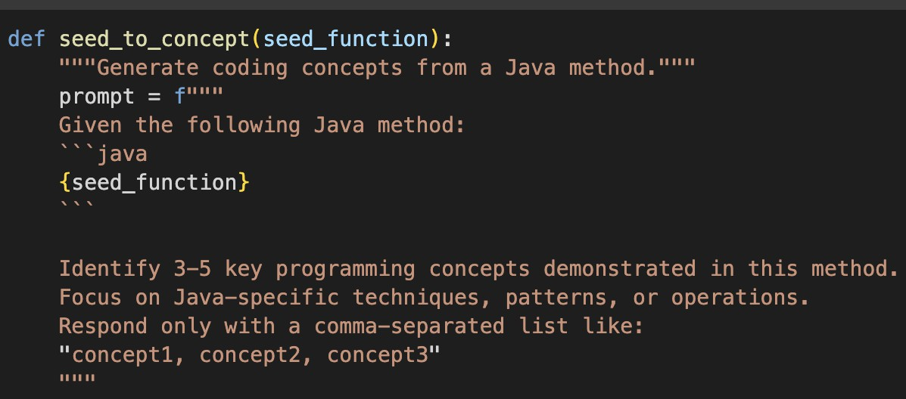
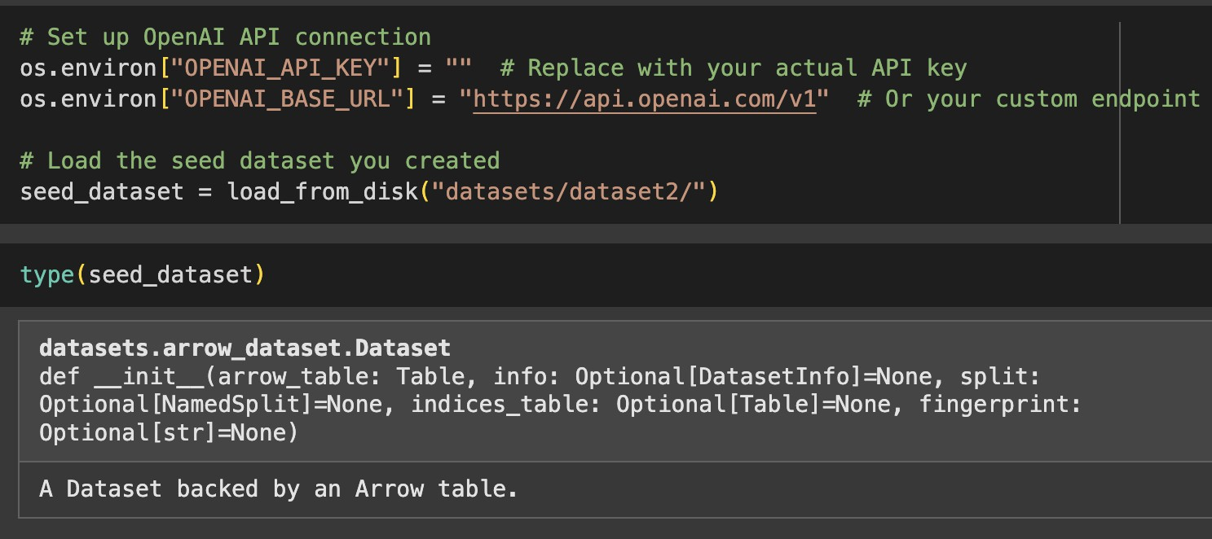
To know what's happening in the function we used seed_to_concept and OpenAI provides it.
Calls seed_to_concept() to identify core concepts like:Recursion, string manipulation, file I/O, etc.
Converts all lists into a structured Hugging Face Dataset. Saves the dataset locally with: s_to_i_dataset.save_to_disk("java_s_to_i_dataset")
We used "model": "gpt-3.5-turbo"

Slide 15
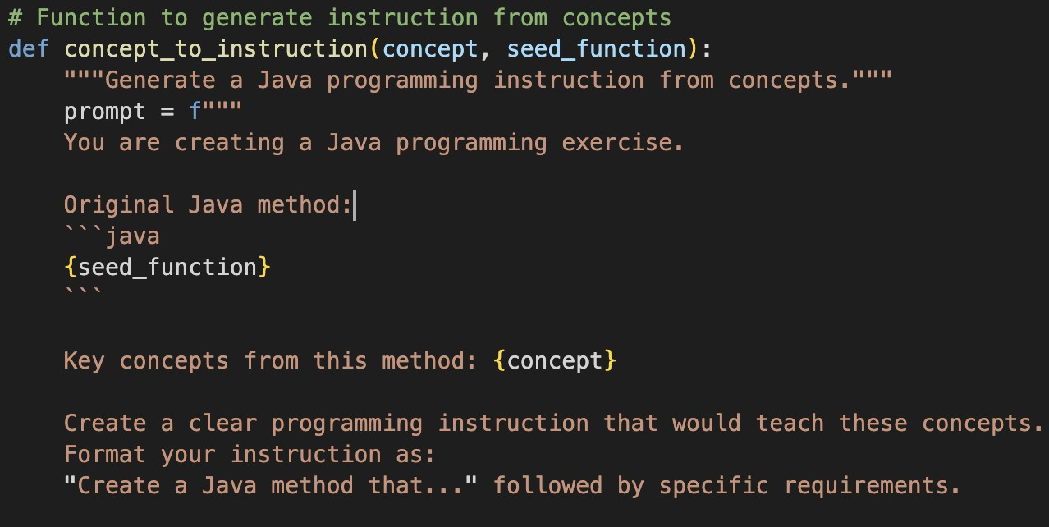
STEP-2 : SELF-OSS-INSTRUCT
Function to generate instruction from concepts
We created a prompt ‘concept_to_instruction’ . It is used to create java instructions from concepts.
Wrapped in a try-except block to catch API or network errors.
Returns an empty string if there's an error, allowing the pipeline to continue smoothly.

Slide 16
We gave instructions like
Create a clear programming instruction that would teach these concepts.
Format your instruction as:
"Create a Java method that..." followed by specific requirements.
We gave paraments for instructions
Specify the method signature (parameters and return type)
Explain what the method should do
Include edge cases if relevant
Be educational and challenging but not overly complex
Now Connecting to OpenAI

Slide 17
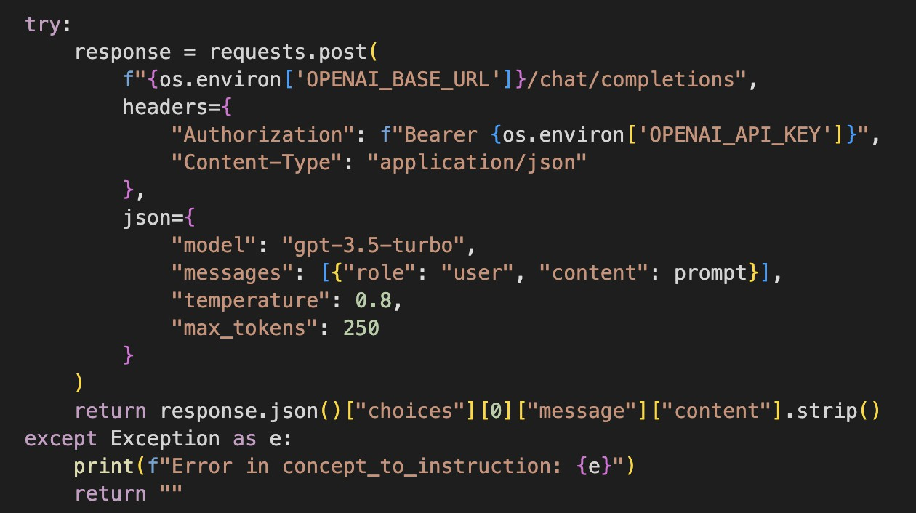
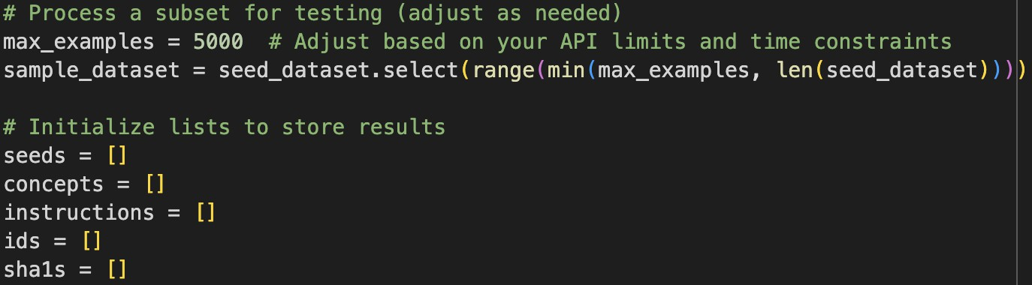
Based on the API limit and time we set max-examples to
5000.
It selects these randomly from dataset and then it becomes sample dataset
The function extracts and returns the generated instruction text from the API response using:
response.json()["choices"][0]["message"]["content"].strip()
On running this sample dataset, we are creating
Instructions
The limit is dynamically applied using:
range(min(max_examples, len(seed_dataset)))

Slide 18
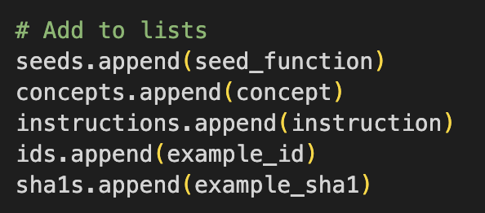
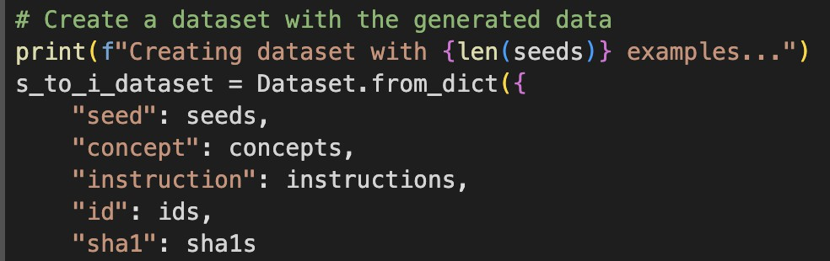
In next dataset we are storing in this format
Lists are simple, efficient, and compatible with HuggingFace’s Dataset.from_dict() method, which is used at the end to save the data.
Created seed to instruction
After collecting all results, I convert the structured lists into a HuggingFace Dataset object.

Slide 19
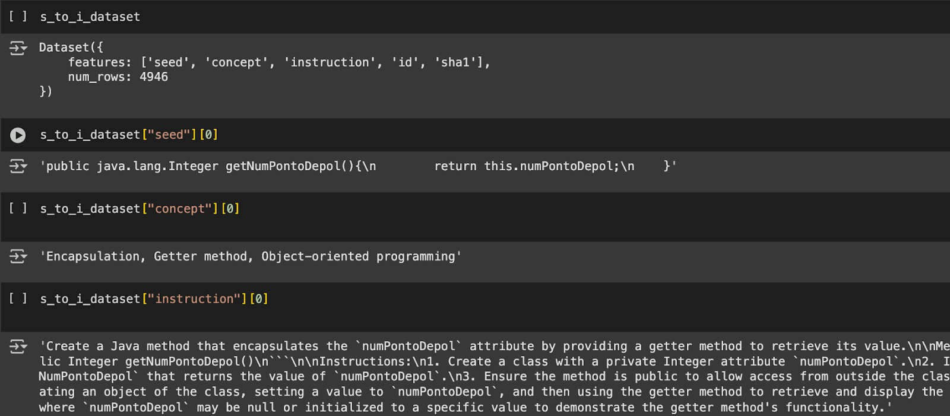
The dataset is saved to disk using save_to_disk() in a folder called "java_s_to_i_dataset”. This allows easy reloading for future use without rerunning the entire pipeline. As we set limit to 5000 characters after skipping all those, we got 4946.
So, it created the instructions in lists.

Slide 20
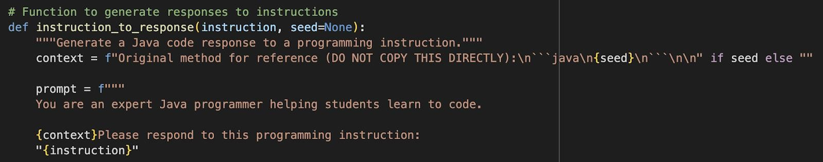
STEP-3: SELF-VALIDATION
In step-3 we generate responses from instructions
Here we take context and giving seed for reference to it
Uses the OpenAI API (with environment variables for API_KEY and BASE_URL) to call the chat/completions endpoint.

Slide 21
We get response in 4 clearly labeled sections:
REASONING: Brief explanation of your approach
SOLUTION: Well-commented Java code implementing the solution
EXPLANATION: How your solution works and your design choices
TEST: Example test cases that verify your code works
We give parameters to Java code:
Follows best practices
Is well-formatted
Is correct and comprehensive
Addresses the exact problem described
Now Connecting to OpenAI

Slide 22
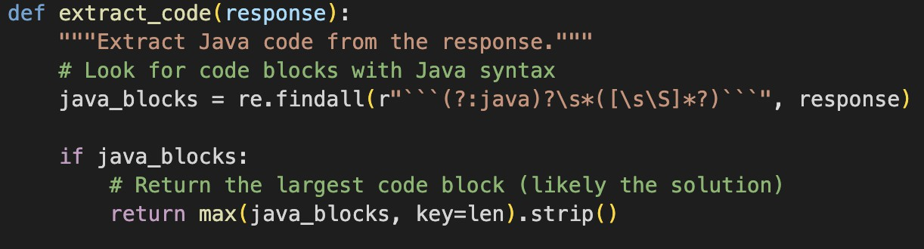
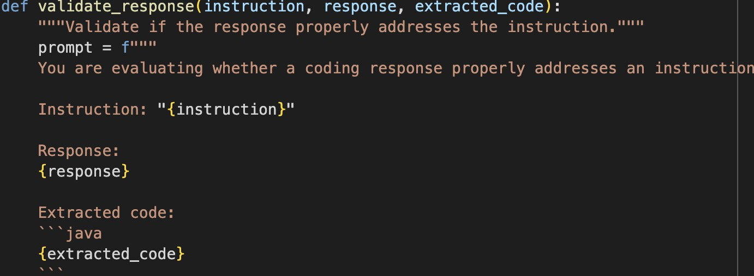
To extract Java code from response we used
Code Extraction Function (extract_code)
Uses regular expressions to find Java code blocks formatted inside triple backticks with optional java syntax.
Selects the largest code block, assuming it contains the main solution.
To validate the response, we used Response Validation (validate_response)
Sends a prompt to the GPT-3.5-turbo model to evaluate if the response meets key criteria:
Presence of all required sections (reasoning, solution, explanation, test)
This step filters out incomplete or incorrect responses programmatically.

Slide 23
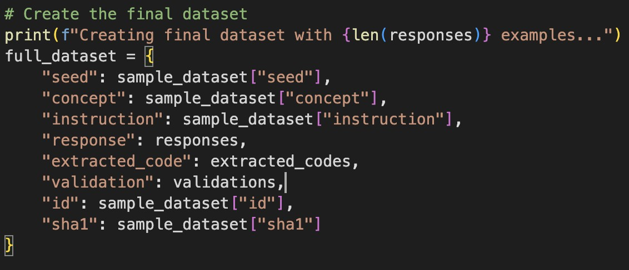
To Evaluate we gave these parameters:
The response directly addresses the specific instruction
The Java code would likely compile without errors
The solution is complete and correct
All required sections (REASONING, SOLUTION, EXPLANATION, TEST) are present
Respond with "PASS" if everything is satisfactory. Respond with "FAIL: [reason]" if any issues are found.
We set max_examples = 1000 and after generating all the responses the final dataset format is

Slide 24
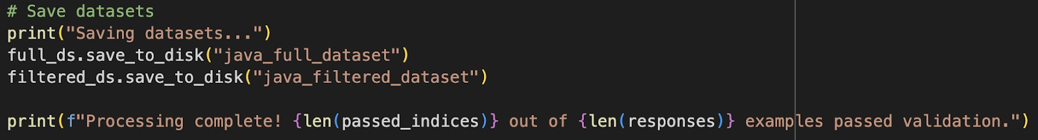
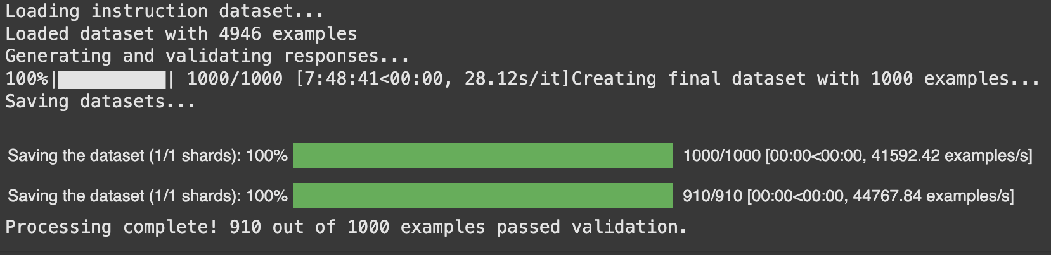
Now saving all passed indices in java filtered dataset
Therefore, 910 out of 1000 examples passed validation.

Slide 25
THANK YOU.

